Slide 1
Methods I Lab Lecture 3

Slide 2
Homework submissions
Name files using the following format:
HW#_LastName.doc or HW#LastName.pdf
Examples:
HW2_Muhammad.doc
HW4_Hyer.pdf
If you have the option to produce a word document, let that be the default choice.
If you’ve missed something and we would like to comment, it is far easier for us and you if it is a word document

Slide 3
Homework #1 Common Mistakes
Please be careful to answer all questions and every part of each question
Graphs should be stand-alone
The information should be all inclusive
If someone cannot look at the graph completely out of context and know exactly what they are looking at, reconsider your titling, description, and labeling

Slide 4
Homework #1 Common Mistakes
NOTE: Standard deviation is not guaranteed to reduce when N increases
Smaller sample sizes only increase the probability and size of error. There is not promise that you’ve over or under estimated in the first place.

Slide 5
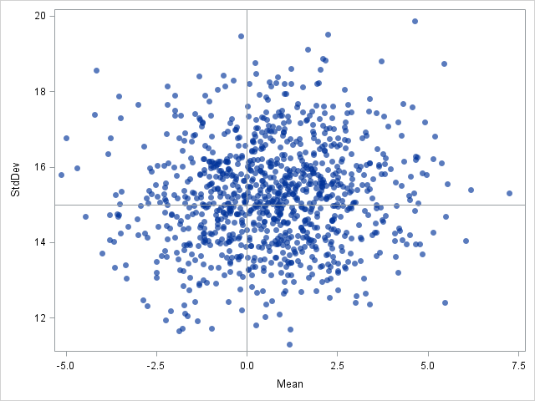
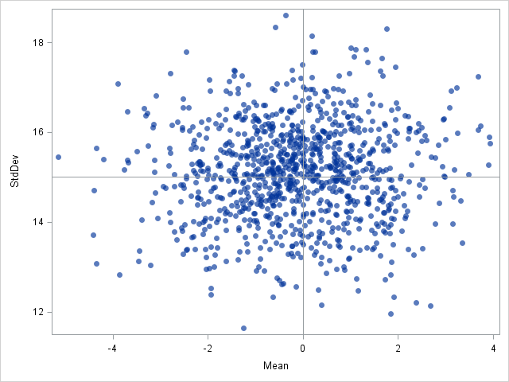
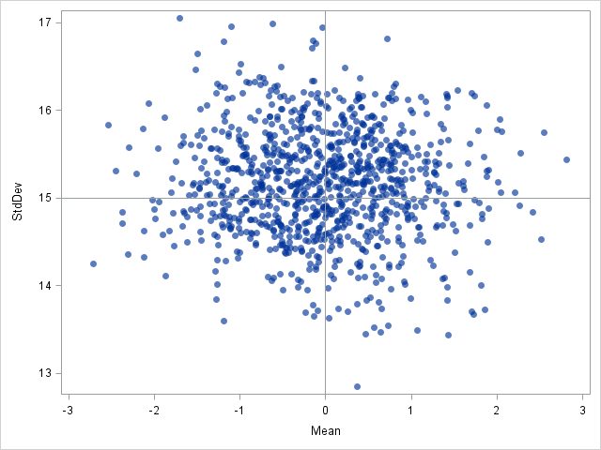
Student’s contribution
N = 25
N = 100
N = 250
Suppose you knew the ‘true’ mean and standard deviation of a population…
Would every subset of that population reflect those values?
Here, subsets of size 25, 100, and 250 are taken from a population of size 2,000 with a mean of 0 and SD of 15

Slide 6
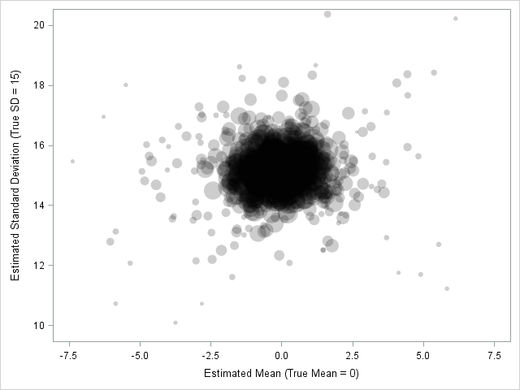
Student’s contribution
There’s no guarantee that a subset of the population will reflect the ‘true’ population parameters
In 1908, W.S. Gossett introduced the idea that there is uncertainty when estimating parameters of a small sample
Here, we see that outliers tended to have a smaller sample size than those mostly centered around the true parameter values
Plot of subset estimated means and SDs, with varying subset sample size up to 500

Slide 7
Onto the good stuff…

Slide 8
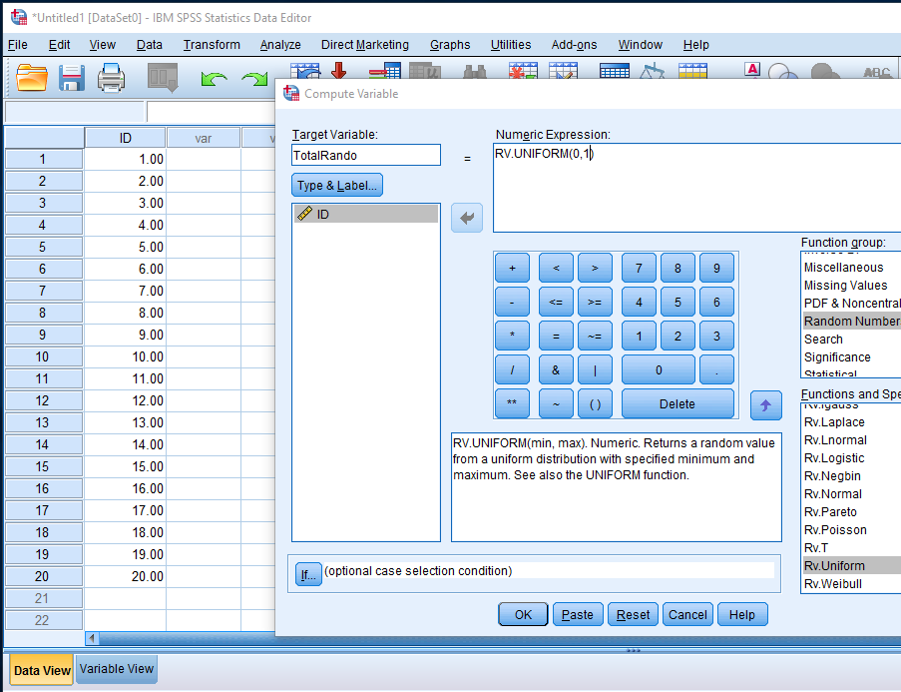
Data in SPSS - Exercise
Make an ‘ID’ variable and list numbers 1 to 20
Generate 2 random numbers using a uniform distribution
Use Rand1 and Rand2 for variable names
Transform
Compute Variable
Function Group: Random Number
Functions &…: Rv. Uniform
Min: 0
Max: 1

Slide 9
Data in SPSS - Exercise
Generate another number that is the product of your first two
I’m naming mine Rand1and2
Transform
Compute Variable
Rand1*Rand2

Slide 10
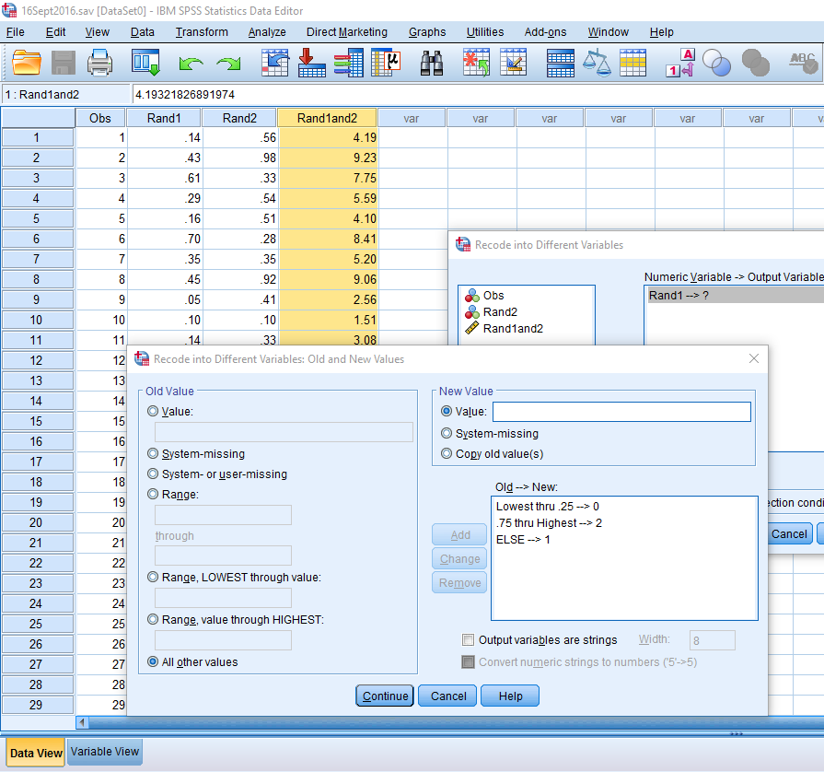
Data in SPSS - Exercise
Make a categorical variable for each of the variables
Have the first be into three groups, the second into two groups, and the third into two groups
In this example
Rand1 cutpoints: .25 and .75
Rand2 cutpoint: .75
Rand1and2 cutpoint: .5

Slide 11
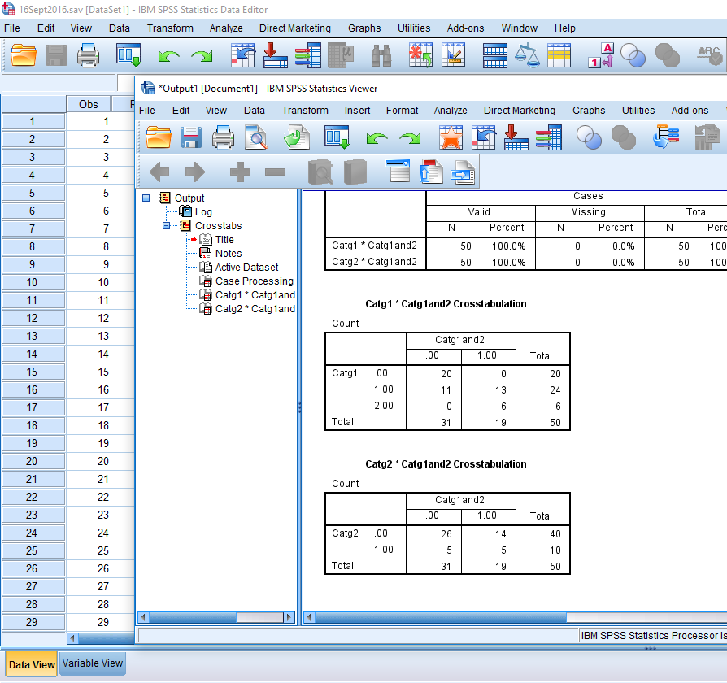
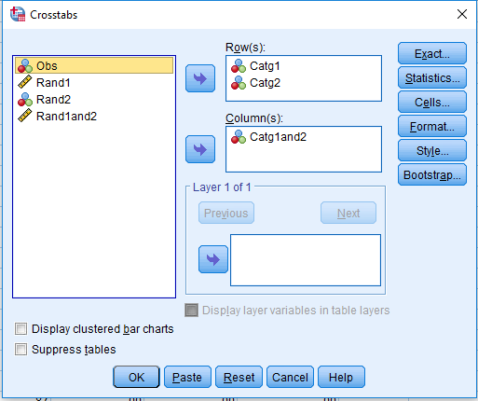
Analysis in SPSS - Exercise
Produce crosstab tables between the first two random variables and the variable you Computed
Analyze
Descriptive Statistics
Crosstabs…
Row(s) :
Column(s):

Slide 12
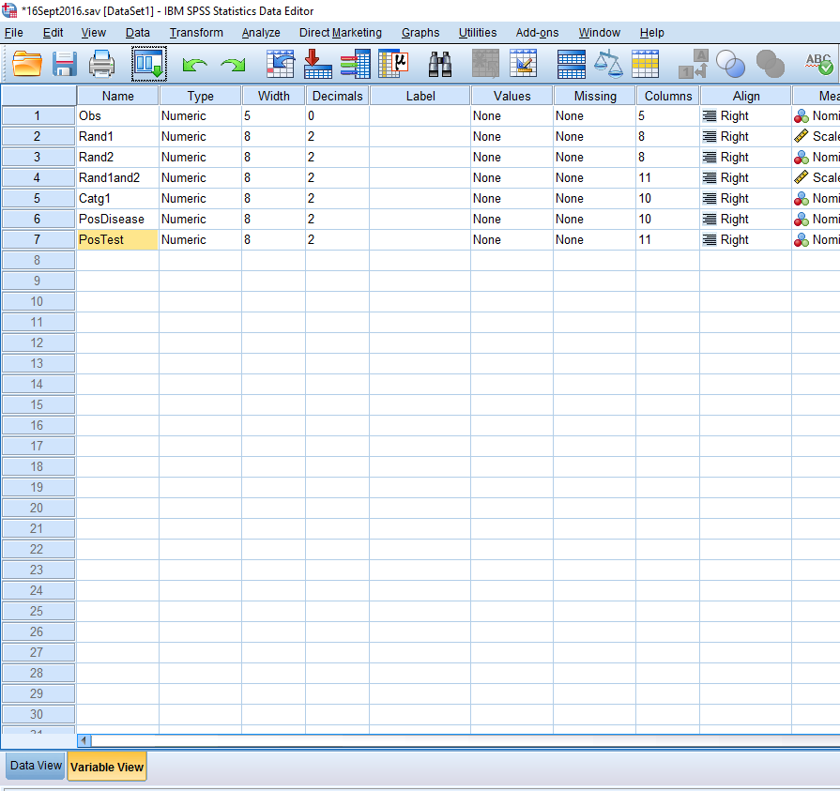
Analysis in SPSS - Exercise
Rename your two binary variables to something that indicates positive disease status for one and positive disease test
Doesn’t matter which is which

Slide 13
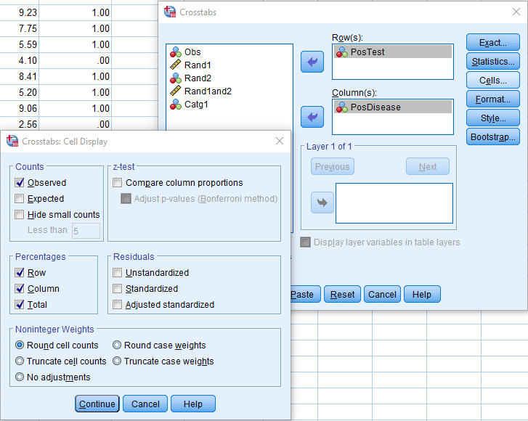
Analysis in SPSS - Exercise
Produce crosstabs with disease status as the column variable and disease testing status on the row
Under ‘Cells…’, request ‘Row’, ‘Column’, and ‘Total’ percentages
Analyze
Descriptive Statistics
Crosstabs…
Row(s) : Positive Test
Column(s): Positive Disease
Cells…
Row, Column, and Total Percentages

Slide 14
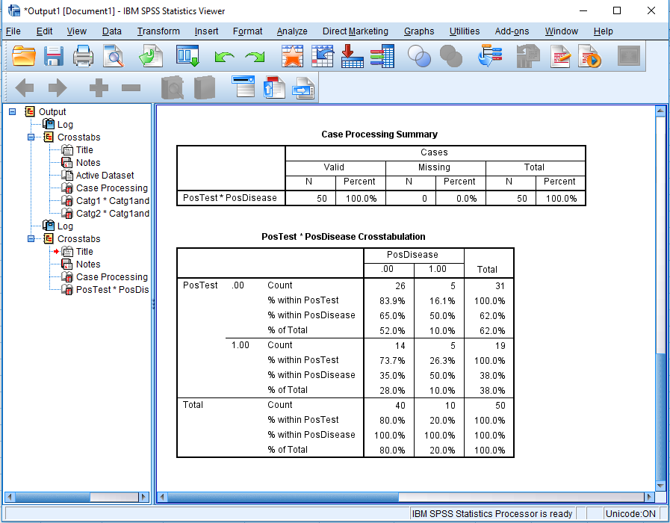
Analysis in SPSS - Exercise
From the output, identify the positive and negative predictive values
Consider what the PPV and NPV is and identify the corresponding %
You shouldn’t get the exact same results as the example without the exact same dataset
If you would like to practice with this dataset, email Madison or Lutfiyya and request it

